Slide 1
Zscaler to Cato
Cato Professional Services

Slide 2
Zscaler Migration Strategy
Policy Conversion & Cato Best Practices
1. EXPORT | 2. REVIEW & MAP
ZIA: Export policies, URL filtering, firewall, web security, DLP, Cloud App policies, Advanced Threat Protection, SSL Inspection, Bandwidth Control, and User/Group settings. ZPA: Export segment groups, access policies, Browser Access, Client Forwarding, Inspection policies, Trusted Networks, Server Groups, and Posture Profiles. | ZIA: Map policies to Global Internet firewall, App Control (Tenant Restrictions, CASB, DLP), Threat Prevention, SCIM groups, and TLS Inspection. ZPA: Review groups, site hosts, map to WAN firewall and access control.
3. DEPLOY | 4. OPTIMIZE
ZIA: Implement Cato best practices, including category and service restrictions, firewall, TLS Inspection, CASB, and DLP monitoring policies. ZPA: Deploy Cato best practices for WAN firewall, segmentation, and Access Control, Browser Access, Trusted Networks, and Group/Host configuration. | ZIA & ZPA: Event analysis, performance tuning, adjust policy restrictions, and enhance security through segmentation.
Notes:
Policy Migration Process
Clean up
Refactoring
Gap analysis to Cato Best Practices

Slide 3
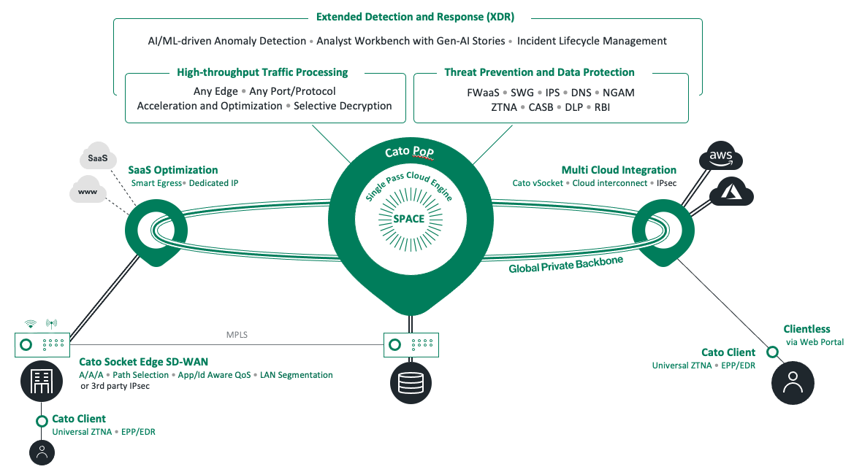
Cato Advanced Security
Servicing PoP Breakout & SDWAN
Zscaler Replacement
Unified Platform
End-to-End Visibility
Long-term Strategic Goal
Simplified and standard solution
Direct Internet Breakout from servicing PoP and SDWAN preference routing

Slide 4
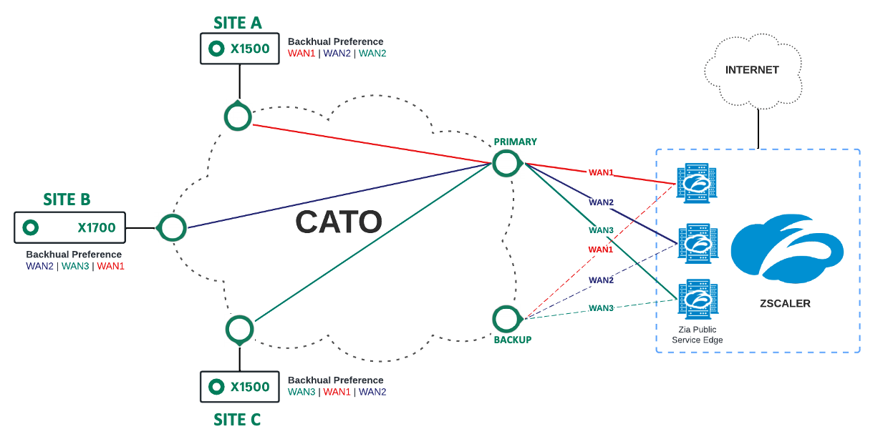
ZIA Gateway Integration – IKEv2 Multiple Active Tunnels
Site Backhaul Load balance over multiple ZIA tunnels
3 x Active IPSec ZIA Tunnels
3 x Backup IPSec ZIA Tunnels
Backhaul Load balanced based on:
Source / Destination
Temporary ZIA interim solution
Support for multiple interconnects
Tier 1 backbone
Egress from closest PoP to Zscaler

Slide 5
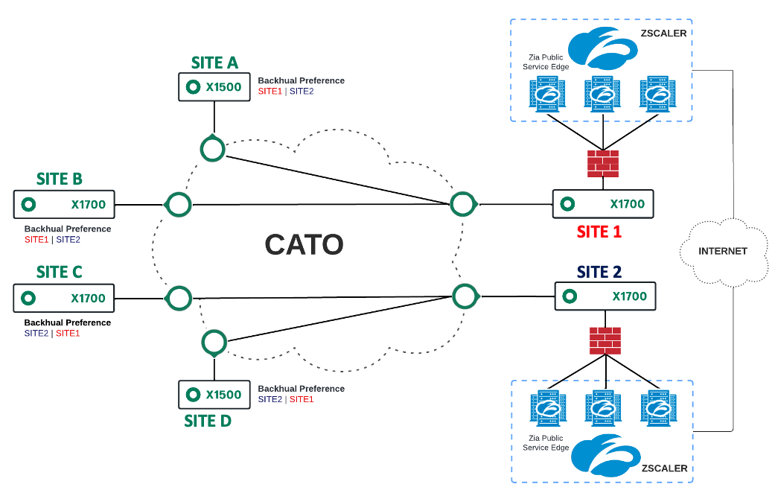
ZIA Integration – Internet Backhaul to FW
Backhaul - Load balance & Site Redundancy
Backhaul Internet Breakout by existing sites
ZIA support from FW for GRE / IPsec
Backhaul Load balanced based on:
Source / Destination
Temporary ZIA interim solution
Reuse of existing FW ZIA connectivity
| 5

Slide 6
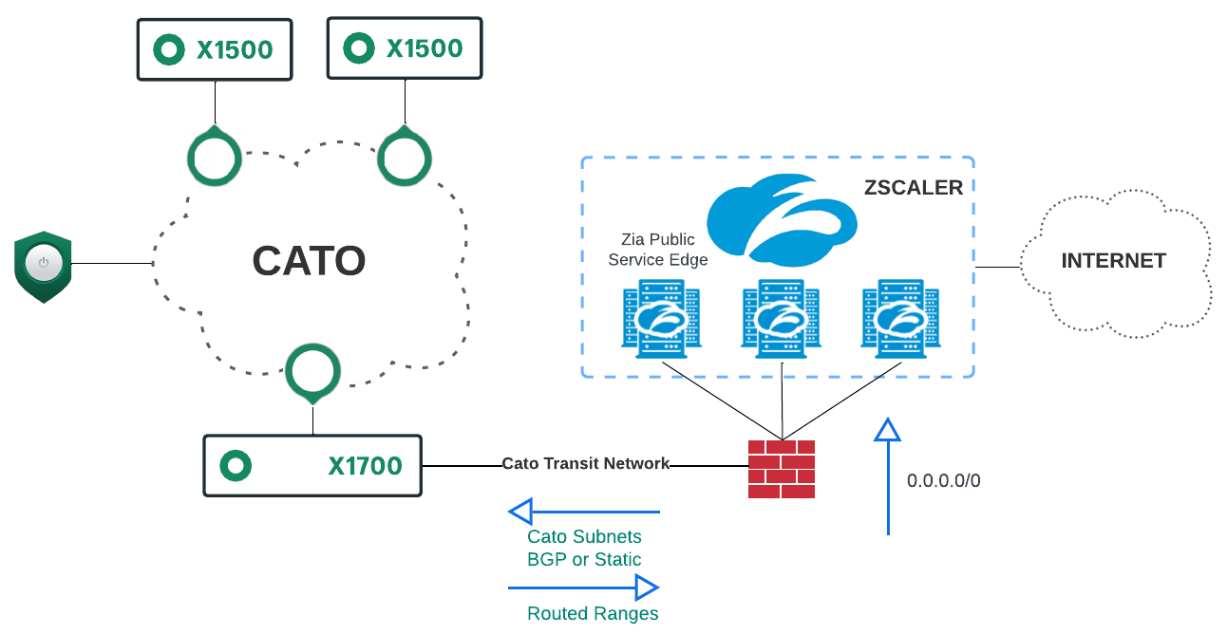
Phased ZIA Replacement – FW VLAN Termination
Parallel ZIA Connectivity through FW
Parallel FW ZIA connectivity
Cato Transit Network
BGP or Static routing
Temporary Cato site routed Ranges
Convert to VLAN during FW retirement
Reuse existing local FW ZIA connectivity
Phased migration to Cato Internet Breakout
Routed Ranges can be used in policy and later converted to VLAN
Simple Bypass of Agent Connectivity
No Cato Bandwidth and commercial impact
| 6

Slide 7
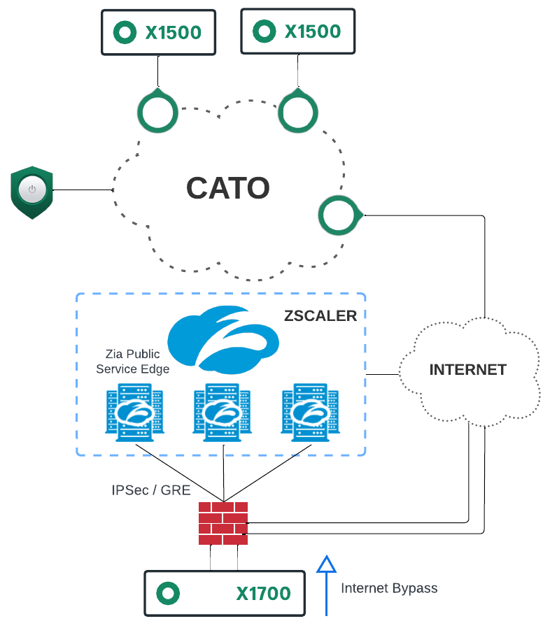
Phased ZIA Replacement – Cato VLAN Termination
Parallel ZIA Connectivity through FW
Parallel FW ZIA connectivity
Internet Traffic Bypass on WAN
FW DMZ handoff for socket WAN
Socket terminates local VLAN
Reuse existing local FW ZIA connectivity
Internet Breakout from FW
Phased migration to Cato Internet Breakout
Socket provides termination of local VLAN
No Cato Bandwidth and commercial impact
Cato managed inter-VLAN & visibility

Slide 8

Case Study - Mourant Ozannes Services Ltd
Business - Legal advisory services
Technical - Using Zscaler ZIA (tunnels and ZCC) with identity for Internet access, not using ZPA
Heavy focus on ZTNA, MPLS for WAN access protected by legacy firewalls
Goal to better protect WAN using ZTNA model
Why Buy - Zscaler ZIA Replacement
Customer extremely unhappy with Zscaler solution
Purchased Zscaler CASB but solution was not working for them

Slide 9
Case Study - Mourant Ozannes Services Ltd
Phase 0 - Sites on Zscaler ZIA tunnels (GRE) + Managed endpoints on Zscaler ZCC
Remote access using legacy Remote Access VPN solution (Forcepoint?)
Migrated sites to Cato sockets
Imploy WAN protect using UA before moving anyone over from Zscaler ZIA
Site routing via PBR of WAN traffic to Cato
Site Internet via default route to Zscaler ZIA via tunnel
Phase 1 - Rollout SDP to all users
Split tunnel RFC 1918 for SD-WAN over Cato
SDP not in always-on, manually enabled when remote
Internet via ZIA over tunnels at sites (default route) and Zscaler ZCC when remote
Co-existing ZCC and SDP on workstations, dual tunnels while remote

Slide 10
Case Study - Mourant Ozannes Services Ltd
Phase 2 - WAN rules completed following ZTNA model
Removed PBR and migrated default route to Cato for WAN access
Non-user systems (e.g., servers, IoT, etc.) migrated to Cato SWG via socket using minimal rule set, maintained visibility and relative security posture
ZTNA policies only using Cato UA identities for enforcement
Zscaler ZIA still running via ZCC on all managed endpoints for Internet protection
Zscaler ZCC tunnel inside Cato socket tunnel when onsite
Zscaler ZCC tunnel and Cato SDP tunnel co-existing when remote
Phase 3 - Copy Zscaler SWG policies into Cato SWG
Testing subset of users by removing Zscaler ZCC agent (on-prem sandbox) and confirmed functionality
Isolated SDP policy dependency from testing methodology
Phase 4 - Clear path to removal of Zscaler ZCC across all managed endpoints
Enable SDP always-on, still split-tunnel RFC 1918, still relying on Zscaler ZCC for ZIA
Big bang removal of split tunnel
SDP provides default route to Internet via Cato POP, ZCC forms ZIA tunnel via Cato to Zscaler POP
Remove Zscaler ZCC client at convenience, Internet traffic flips from Zscaler ZIA to Cato SWG

Slide 11
Case Study - Mourant Ozannes Services Ltd
Results
Full SDP for remote access and SWG
Eliminated Zscaler ZIA and ZCC solution
Eliminated legacy remote access VPN solution
Future Projects
Phase X - CASB & DLP - Achieve security posture originally desired when using Zscaler
Phase Y - Eliminate legacy firewall platform for only Cato NGFW
Hindsight Being 20/20
All SDP users being identified as "All Unidentified Users" group while logic for specific users groups worked behind socket, caused SWG policy logic failure
Flaw in Cato logic, being fixed, and quickly resolved using exception for All SDP Users groups
TLSi caused issues with Outlook, change management delayed diagnostic testing, resulted in little more than a month delay in rollout
Issue on customer side, resolved via Cato support ticket
Tight change control and windows resulted in extremely slow progress
Looking Forward
Integrated (recently released) SDP agenda-based identity with WMI based identity to improve UA experience
Utilization of (soon to be released) user/group based split tunnel policies to simplify Phase 3 testing and Phase 4 gradual cutover

